Slide 1
Topic: Algebra: Simplifying expressions EQ: What is a Liked Term and How do I collect them?
Year 8 Mathematics
Mrs Parlevliet

Slide 2
Contents
Glossary or Formula Page
Page
Date
Description

Slide 3
Tasks
24
7
30
Essential Question
Questions
Notes
Summary
1
2

Slide 4
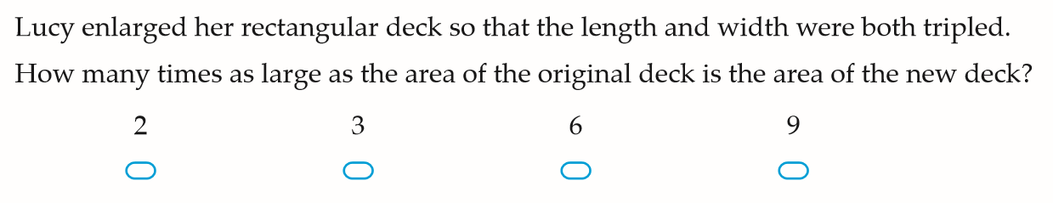

Five Questions (LHS)
Date: __/6/2019
Topic: Algebra
EQ – What are like terms and how do I collect them?
Write the summary to yesterday’s lesson.
What are the terms in this expression? $3x+5y−12xy+15$
What is the perimeter of a semi-circle with a radius of 4cm?
If Mrs Parlevliet has 3 oranges and is given another 2 oranges and 4 apples, how many oranges and apples does she have?

Slide 5
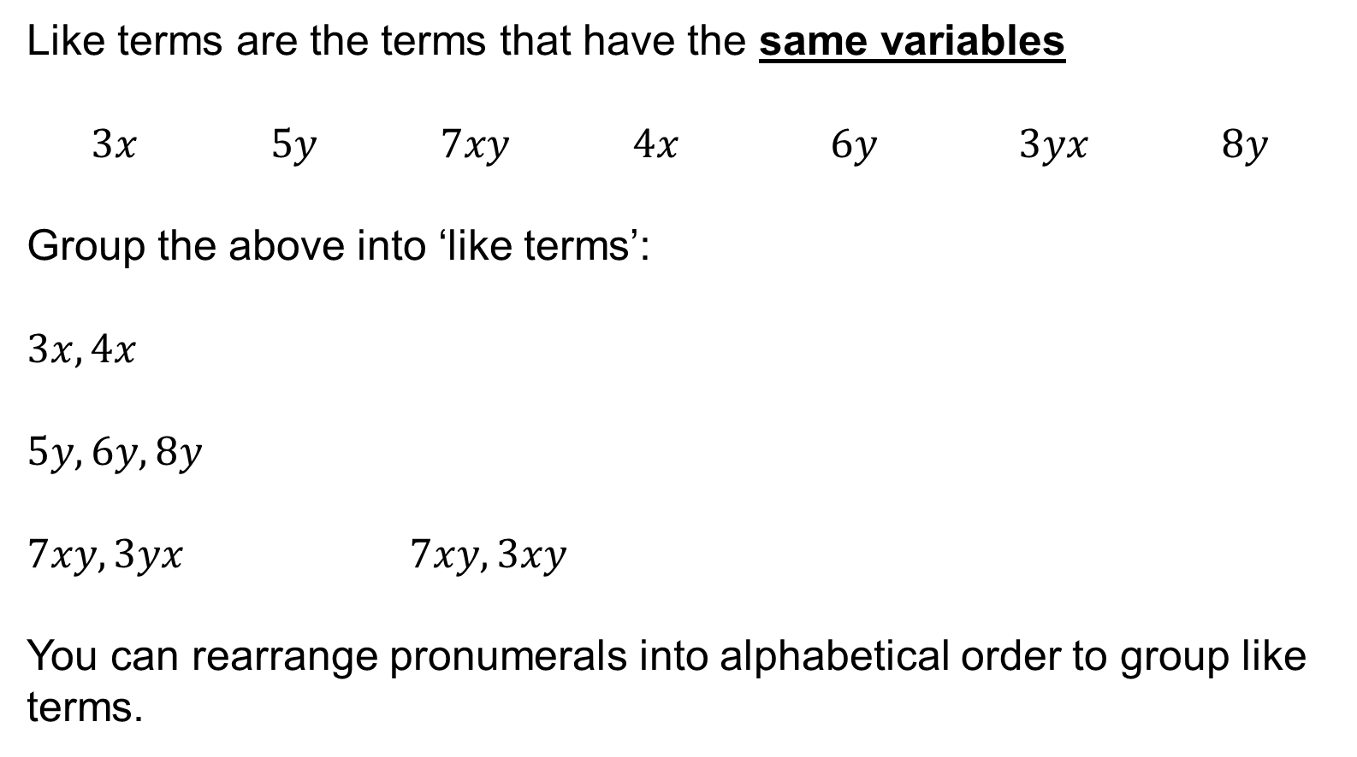
24
7
30
Algebra: Simplifying Expressions
WICOR
Date: __/6/2019
EQ – What are like terms and how do I collect them?
What is a like term?
Like terms are the terms that have the same variables
$3x 5y 7xy 4x 6y 3yx 8y$
Group the above into ‘like terms’:
$$3x, 4x$$
$$5y, 6y, 8y$$
$7xy, 3yx$ $7xy, 3xy$
You can rearrange pronumerals into alphabetical order to group like terms.

Slide 6
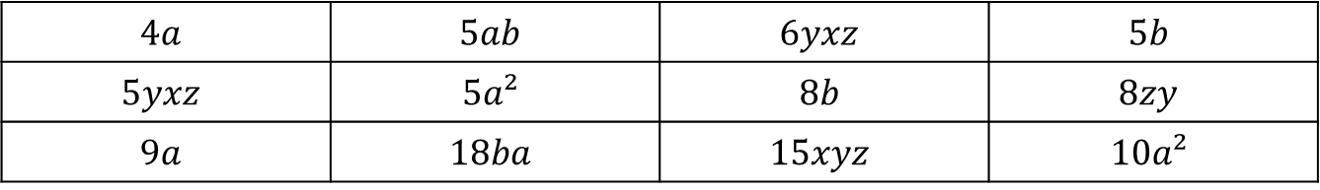
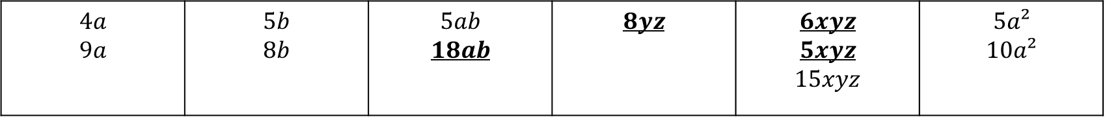
Practice: lhs
GROUP THE FOLLOWING INTO LIKE TERMS
$$4a$$ | $$5ab$$ | $$6yxz$$ | $$5b$$
$$5yxz$$ | $$5a²$$ | $$8b$$ | $$8zy$$
$$9a$$ | $$18ba$$ | $$15xyz$$ | $$10a²$$
$$4a$$ $$9a$$ | $$5b$$ $$8b$$ | $$5ab$$ $$18ab$$ | $$8yz$$ | $$6xyz$$ $$5xyz$$ $$15xyz$$ | $$5a²$$ $$10a²$$

Slide 7


Slide 8

24
7
30
Algebra: Simplifying Expressions
WICOR
Date: __/6/2019
EQ – What are like terms and how do I collect them?
How do I add and subtract like terms?
Like terms can be combined when they are added or subtracted to simplify the expression.
Example:
$3xy+ 5yx =$
$6b+ 5b −10b =$
$10a −15a=$

Slide 9
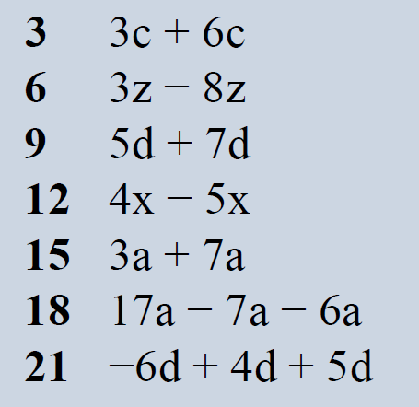
Practice: lhs
9c
-5z
12d
-x
10a
4a
3d

Slide 11


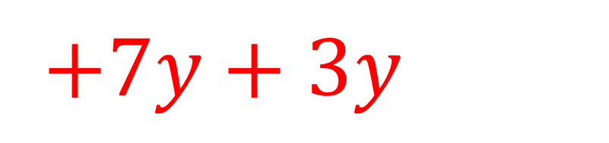


24
7
30
Algebra
WICOR
Date: __/6/2019
EQ – What are like terms and how do I collect them?
How do I add and subtract like terms when there are different terms?
$$3x+7y −2x +3y$$
$$3x−2x$$
$+7y+3y$
$x$
$+ 10y$

Slide 12
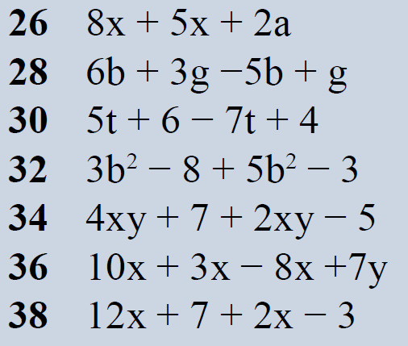
Practice: lhs

Slide 14
Task

Slide 15
Answers

Slide 16

Write Your SUmmary
You have 3 minutes to write a summary that answers the Essential Question.
Be prepared to share your summary with the people sitting in your row.
This Photo by Unknown Author is licensed under CC BY-NC-ND

